Slide 1
SharePoint Online Automation Using PowerShell - A Beginner’s Guide
Andy Dawson MVP

Slide 2




@W4050
blogs.blackmarble.co.uk/blogs/adawson

Slide 3
Introduction
A few questions…
What are we trying to Achieve?
Terms
Options and required components
Getting connected
Tenant automation
Site collection automation
Other automation

Slide 4
A Few Questions…
Who is using SharePoint Online?
Who already knows PowerShell?
Who is already configuring SharePoint Online using PowerShell?

Slide 5
What Are We Trying To Achieve?
Configuration of SharePoint Online using the GUI
Takes a long time
Prone to errors
Repetition of actions
Configuration of SharePoint Online using PowerShell
Scripting overhead
Repeatable
Less prone to errors

Slide 6
What Are We Trying To Achieve?
Configuration of SharePoint Online using the GUI
Reduce the time taken to configure SharePoint
Reduce the number of errors in configuration
Eliminate repetition of actions (boredom leads to errors)
Configuration of SharePoint Online using PowerShell
Far better control of configuration
Repeatable configuration allows easy deployment to multiple tenants
Self-documenting; ensure you use source control!

Slide 7
Terms
Tenant level
Configuration of items at the tenant level includes:
Creation of site collections
Term store manipulation
Search configuration manipulation
Etc.

Slide 8
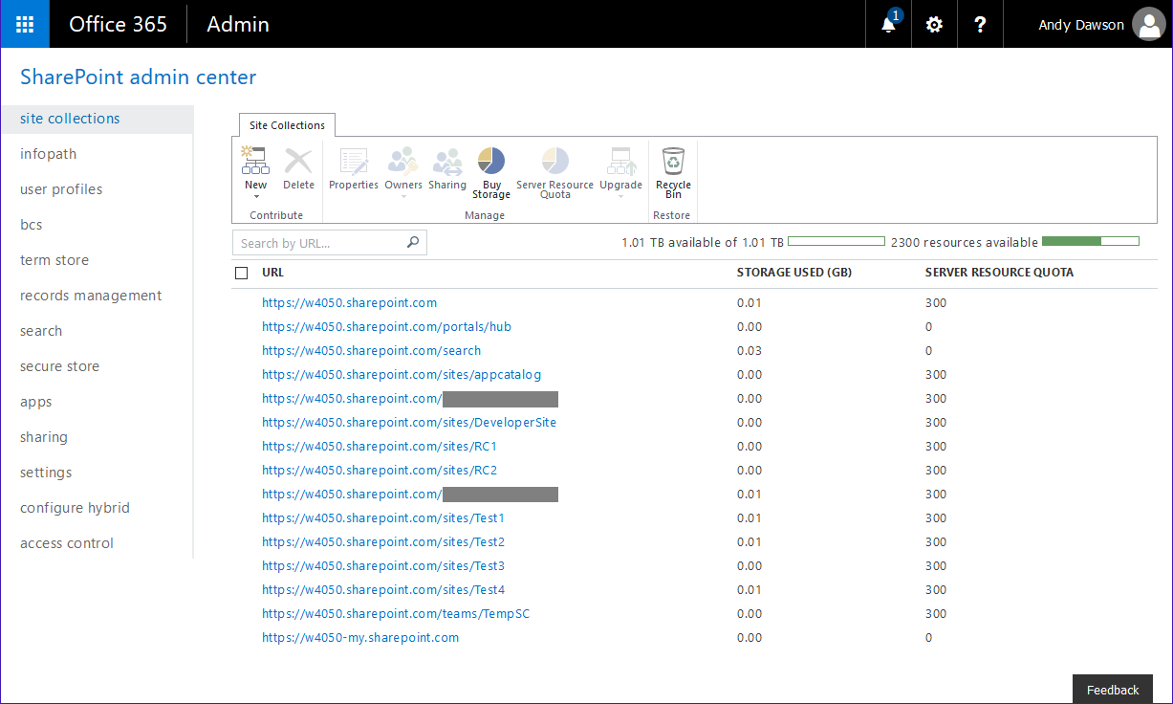
Tenant Admin GUI Page

Slide 9
Terms
Site collection (and sub-sites) level
Configuration of items at the site collection (and sub-site) level includes:
Navigation
Site features
Content types
Site permissions
Structure (sub-site, library, folder)
Etc.

Slide 10
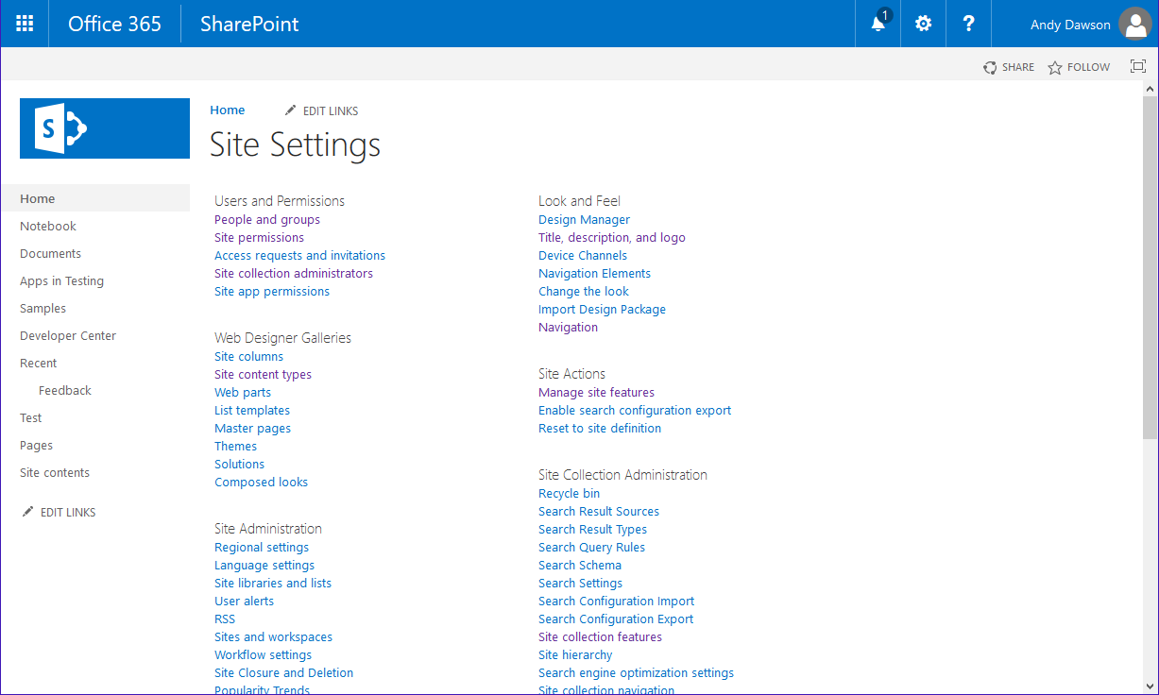
Site Collection Admin GUI Page

Slide 11
Terms
Library level
Configuration of items at the library level includes:
Versioning settings
Library/folder/item permissions
Manipulation of items within a list/library
Etc.

Slide 12
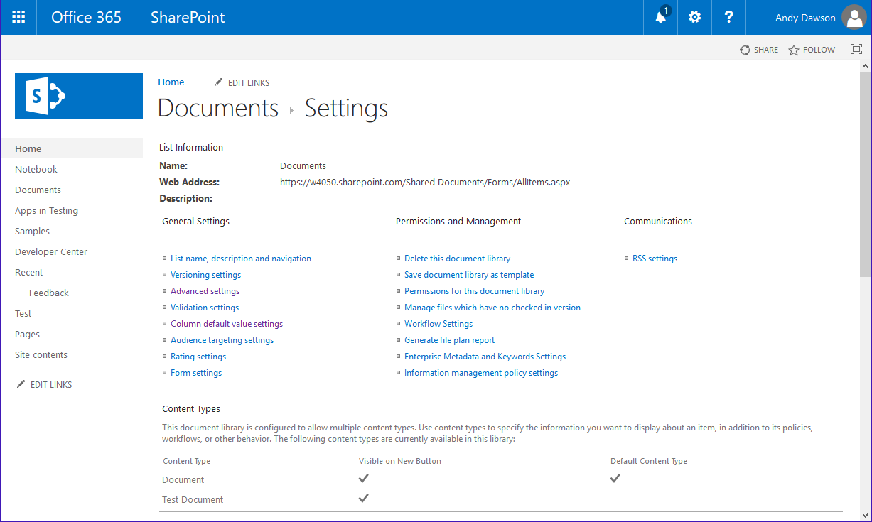
Site/Feature Admin GUI Page

Slide 13
PowerShell Options
SharePoint Online Management Shell
Basic, tenant level admin
SharePoint PnP PowerShell
Far more fully featured
Maturing rapidly
CSOM PowerShell
Roll-your-own
More complex
The only option for items not covered by the above frameworks
Also Office 365 PowerShell for user and license administration

Slide 14
SharePoint Online Management Shell
Add/Get/Remove/Set-SPOUser
Get-SPOExternalUser
Get/New/Remove/Set-SPOSiteGroup
Get/Remove/Restore-SPODeletedSite
Get/New/Remove/Repair/Set/Test/Upgrade-SPOSite
Get/Set-SPOTenant
Get/Remove/Set-SPOTenantSyncClientRestriction
New commands are being added!
Notes:
Limited number of commands, (although a few are not listed above), so can list them here
Theme generator is at aka.ms/spthemebuilder

Slide 15
SharePoint PnP PowerShell
Apps
Base cmdlets
Branding
Client-side pages
Content types
Document sets
Event receivers
Features
Fields
Files and folders
Information management
Lists
Microsoft Graph
Provisioning

Slide 16
SharePoint PnP PowerShell
Publishing
Records management
Search
SharePoint recycle bin
SharePoint WebHooks
Sites
Taxonomy
Tenant administration
User and group management
User profiles
Utilities
Web parts
Webs
Workflows
Notes:
Not everything is covered by this, e.g. the creation of a new site collection has only just been added!

Slide 17
CSOM PowerShell
Not all configuration options are covered, even by this!
See the Office 365 blog for information on the CSOM version

Slide 18
Obtaining and Installing
SharePoint Online Management Shell
Download from https://www.microsoft.com/en-us/download/details.aspx?id=35588
Downloads as an .msi file
If you have a previous version, this will have to be uninstalled before the new version can be installed
The version number of this matches the Microsoft.SharePointOnline.CSOM module (see later), so you should try to keep this up-to-date

Slide 19
Obtaining and Installing
SharePoint PnP PowerShell
https://github.com/SharePoint/PnP-PowerShell
Install-Module SharePointPnPPowerShellOnline
Ends up in C:\Program Files\WindowsPowerShell\Modules\SharePointPnPPowerShellOnline\<version>
Or download the setup files and install the cmdlets manually
Updated monthly.
You can work with a specific version if required, but recommended to keep up-to-date
Older versions may have incompatibilities with later versions of SharePoint Online

Slide 20
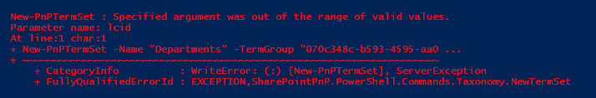
Failing To Update Can Lead To…

Slide 21
Obtaining and Installing
CSOM PowerShell
grab nuget.exe from https://www.nuget.org/downloads
nuget.exe install Microsoft.SharePointOnline.CSOM
This will install to a set of sub-folders in the current directory
Or, can be installed globally (within the C:\Program Files\PackageManagement\NuGet\Packages\Microsoft.SharePointOnline. CSOM.<version>\lib folder) by using install-package microsoft.sharepointonline.csom -Source nuget.org
New version released monthly with new functionality. See https://dev.office.com blog or https://techcommunity.microsoft.com for announcements (although these tend to be hard to find).

Slide 22
Obtaining and Installing Notes
SharePoint Online Shell and SharePoint PnP PowerShell used to have a namespace clash.
The order of installation therefore used to be important
This has been resolved and is no longer an issue
Keep PnP PowerShell and CSOM modules up to date!

Slide 23
Getting Connected
A required part of the procedure
You cannot skip this step; nothing works without it!
SharePoint Online Management Shell
Connect-SPOService -Url https://mydomain-admin.sharepoint.com -credential admin@mydomain.[onmicrosoft.]com

Slide 24
Getting Connected
SharePoint PnP PowerShell
Connect-PnPOnline –Url https://mydomain.sharepoint.com
Use Disconnect-PnPOnline at the end of your session
Has some funky options, including
-CurrentCredentials
-SPOManagementShell
-AppId <String>-AppSecret <String>
-Credentials <String> - will look up cred set in the Windows Credentials Manager

Slide 25
Getting Connected
CSOM PowerShell
Add-Type -Path "<pathtoCSOMmodule>\Microsoft.SharePoint.Client.dll"
Add-Type -Path "<pathtoCSOMmodule>\Microsoft.SharePoint.Client.Runtime.dll"
$siteUrl = “https://mydomain.sharepoint.com/”
$username = "Andy@mydomain.onmicrosoft.com"
$password = Read-Host -Prompt "Enter password" -AsSecureString
$ctx = New-Object Microsoft.SharePoint.Client.ClientContext($siteUrl)
$credentials = New-Object Microsoft.SharePoint.Client.SharePointOnlineCredentials($username, $password)
$ctx.Credentials = $credentials
Notes:
See, I told you that you have to do everything yourself!

Slide 26
Tenant Config – New Site Collection
Notes:
Note that assume that all scripts have a connection block at the top

Slide 27
New Site Collection
SharePoint Online Management Shell
New-SPOSite -Url https://mydomain.sharepoint.com/sites/Test -Owner andy@mydomain.onmicrosoft.com -StorageQuota 1000 -Title "Test Site Collection“ -Template STS#0
SharePoint PnP PowerShell
New-PnPTenantSite -Url https://blackmarbledev.sharepoint.com/sites/Test -Owner andy@mydomain.onmicrosoft.com -TimeZone 2 -Title "Test Site Collection" -Template STS#0 -StorageQuota 1000
Notes:
Note: Async
SP PnP PowerShell had this as a beta feature for quite a while
Note that New-PnPTenantSite allows only a limited set of Lcids at site collection creation. Can then be changed following creation.
$web = $ctx.Web;
$ctx.Load($web);
$ctx.ExecuteQuery();
$web.RegionalSettings.LocaleId = 2057;
$web.Update();
$ctx.ExecuteQuery();

Slide 28
New Site Collection
CSOM PowerShell
<Connection stuff goes here>
$tenant = New-Object Microsoft.Online.SharePoint.TenantAdministration.Tenant($ctx)
$SCproperties = New-Object Microsoft.Online.SharePoint.TenantAdministration.SiteCreationProperties $SCproperties.Url = $newsiteUrl $SCproperties.Template = "STS#0“ $SCproperties.Owner = $username
$SCproperties.StorageMaximumLevel = 1000
$SCproperties.UserCodeMaximumLevel = 300
$SCproperties.Title = "Test 3“
$tenant.CreateSite($SCproperties)
$ctx.ExecuteQuery()
Notes:
Also async

Slide 29
Demo - New Site Collection

Slide 30
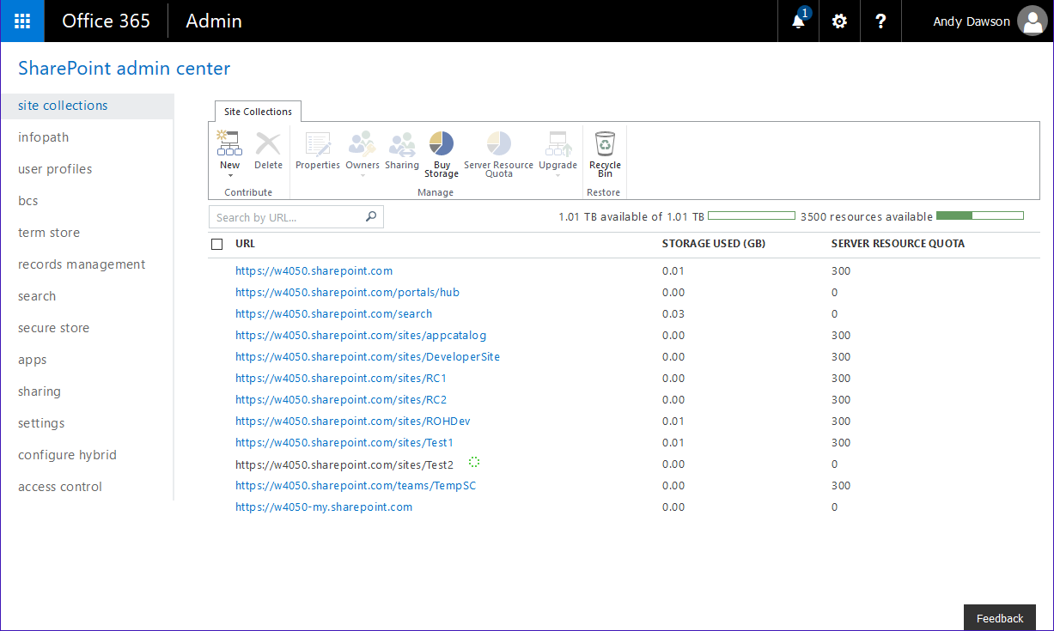

Slide 31
Tenant Config - New Term Set

Slide 32
New Term Set
SharePoint Online Management Shell
Operation not supported
SharePoint PnP PowerShell
New-PnPTermGroup -GroupName "Corporate Terms“
New-PnPTermSet -Name "Departments" -TermGroup "Corporate Terms" -Lcid 1033
New-PnPTerm -TermSet "Departments" -TermGroup "Corporate Terms" -Name "Finance" -Lcid 1033
New-PnPTerm -TermSet "Departments" -TermGroup "Corporate Terms" -Name "HR" -Lcid 1033

Slide 33
New term Set
CSOM PowerShell
$MMS = [Microsoft.SharePoint.Client.Taxonomy.TaxonomySession]::GetTaxonomySession($session)
$session.Load($MMS) $session.ExecuteQuery()
#Retrieve Term Stores $termStores = $MMS.TermStores $session.Load($termStores) $session.ExecuteQuery()
#Bind to Term Store $termStore = $termStores[0] $session.Load($termStore) $session.ExecuteQuery()

Slide 34
New term Set (2)
CSOM PowerShell
$group = $termStore.CreateGroup("Corporate",[System.Guid]::NewGuid().toString()) $session.Load($group) $session.ExecuteQuery()
#Set Group description $group.description = "Term Group Description“ $session.Load($group) $session.ExecuteQuery()
#Create TermSet $termSet = $group.CreateTermSet("Depts",[System.Guid]::NewGuid().toString(),1033) $session.Load($TermSet) $session.ExecuteQuery()

Slide 35
New term Set (3)
CSOM PowerShell
#Set TermSet Properties $termSet.Description = "Term Set Description“ $termSet.IsAvailableForTagging = $true $termSet.IsOpenForTermCreation = $true $session.Load($termSet) $session.ExecuteQuery()
#Create Appropriate terms $session.Load($termSet) $NewTerm = $termSet.CreateTerm("IT", 1033, [System.Guid]::NewGuid().toString()) $session.Load($NewTerm) $session.ExecuteQuery()

Slide 36
Demo - New Term Set

Slide 37
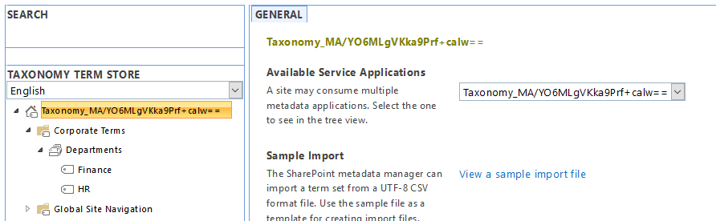

Slide 38
Site Collection Config – Feature Activation

Slide 39
Feature Activation
SharePoint Online Management Shell
Operation not supported
SharePoint PnP PowerShell
Connect-PnPOnline -Url https://mydomain.sharepoint.com/sites/sitecoll
Enable-PnPFeature -Identity f6924d36-2fa8-4f0b-b16d-06b7250180fa -Scope Site

Slide 40
Feature Activation
CSOM PowerShell
$spoCtx.RequestTimeout = -1 $spoCtx.ExecuteQuery()
$guiFeatureGuid = [System.Guid] $sFeatureGuid $spoSite=$spoCtx.Site $spoSite.Features.Add($sFeatureGuid, $true, [Microsoft.SharePoint.Client.FeatureDefinitionScope]::None) $spoCtx.ExecuteQuery()

Slide 41
Demo – Feature Activation

Slide 42
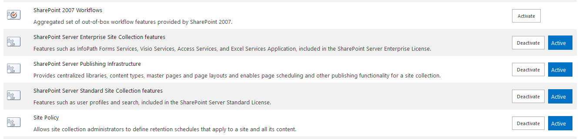

Slide 43
Site Config – New Document Library

Slide 44
New Documents Library
SharePoint Online Management Shell
Operation not supported
SharePoint PnP PowerShell
Connect-PnPOnline -Url https://mydomain.sharepoint.com/sites/sitecoll
New-PnPList -Title "Finance Documents" -Template DocumentLibrary -EnableVersioning -OnQuickLaunch

Slide 45
New Document Library
CSOM PowerShell
$lci = New-Object Microsoft.SharePoint.Client.ListCreationInformation $lci.title = $listTitle $lci.description = $listDescription $lci.TemplateType = $listTemplate
$spoCtx.web.lists.add($lci) $spoCtx.executeQuery()

Slide 46
Demo – New Document Library

Slide 47
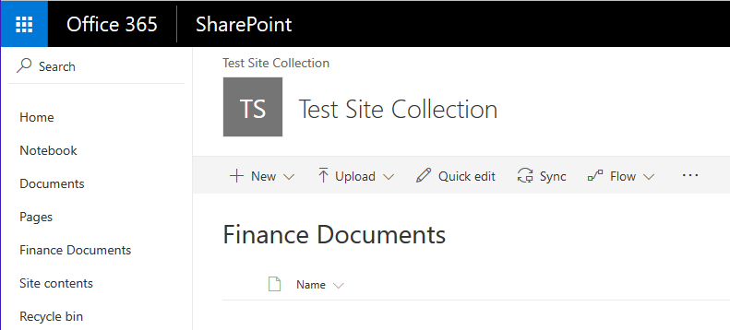

Slide 48
Site Config – Delete List

Slide 49
Delete List
SharePoint Online Management Shell
Operation not supported
SharePoint PnP PowerShell
Connect-PnPOnline -Url https://mydomain.sharepoint.com/sites/SiteColl
Remove-PnPList -Identity "Finance Documents" -Force -Recycle

Slide 50
Delete List
CSOM PowerShell
$list = $spoCtx.Web.Lists.GetByTitle('Finance Documents’) $spoCtx.Load($list) $spoCtx.ExecuteQuery()
$list.DeleteObject() # Really removes it (no recycle bin) $spoCtx.ExecuteQuery()

Slide 51
Demo – Delete List

Slide 52
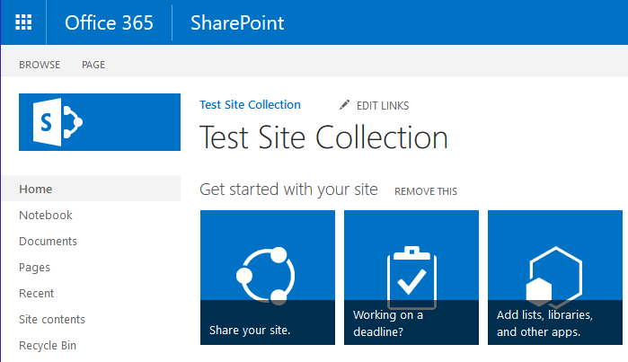

Slide 53
A few additional notes…
Using PowerShell you need to do pretty much everything yourself.
Don’t assume that something will be created for you, check!
Most stuff is anysc (i.e. fire and forget) – this can cause issues if you’re wanting a chain of things to happen.
Read the documentation for the PnP commands carefully. Read the error messages even more carefully!
Some parameters that are shown as optional may be required if, e.g., your site locale is set differently.

Slide 54
Call To Action
Sign up for an Office 365 Developer Tenant – they’re free! *
https://dev.office.com/sharepoint and follow the instructions in ‘Start Building’ -> ‘Set up your Office 365 tenant’
Use the samples in this presentation to get you going
Start using PowerShell to automate configuration of SharePoint Online for production
* Single user for one month. ~£6/user/month otherwise

Slide 55
Questions?
@W4050
blogs.blackmarble.co.uk/blogs/adawson

